Slide 1
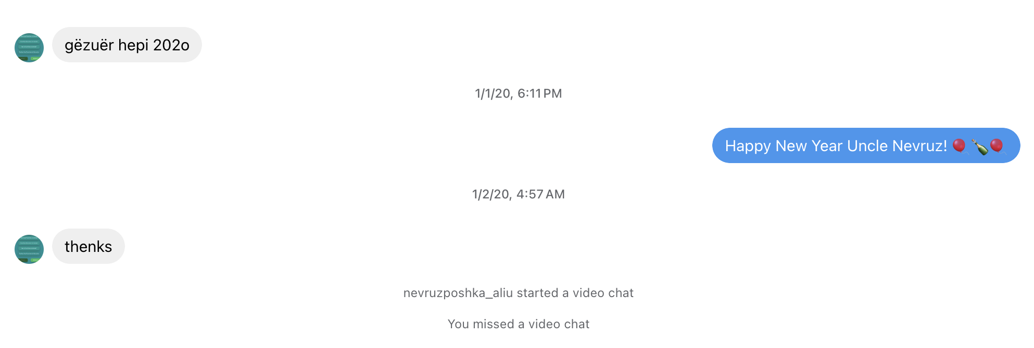

Slide 2


Slide 3
Subtext: the art of characterization through dialogue
Many people go through years of therapy learning how to communicate their needs and desires clearly; this is emotionally healthy
Emotionally healthy characters are boring characters
  We want to read about liars, the emotionally stunted, those who don’t know what they want, those who know what they want but don’t know how to get it, those who work against their own self-interests, etc.
  How can we simultaneously accurately render our deficient characters through dialogue while still making their true motivations clear to the reader? Through subtext.

Slide 4
Dialogue of literal misunderstanding
Characters attempt to reveal something, but meaning is misunderstood
  Miscommunication by speaker
  Cultural differences
  Language barrier

Slide 5
Dialogue of deception
Characters deliberately articulate information that’s factually or emotionally inaccurate
  To manipulate/mislead another character for their own gain
  To protect themselves from vulnerability, rejection

Slide 6
Dialogue of avoidance
Characters articulate something entirely unrelated to the what they desire to express
  To protect themselves
  To protect the interlocutor

Slide 7
Explicit dialogue
Characters deliver information that’s factually and/or emotionally accurate and is clearly understood by the receiver
  To foster a genuine understanding between characters
  To sever connection/hurt the receiver, as in an argument

