Slide 1
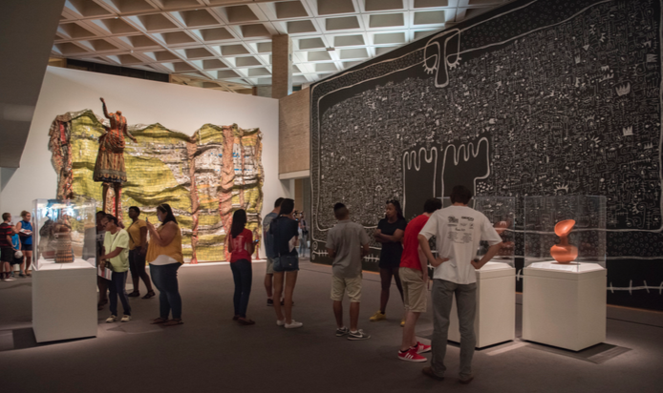
Five Years in the Making: African Art Curation and Public-Facing Scholarship
Dr. Elizabeth Perrill,
Associate Professor, University of North Carolina at Greensboro
Consulting Curator for African Art, North Carolina Museum of Art

Slide 2
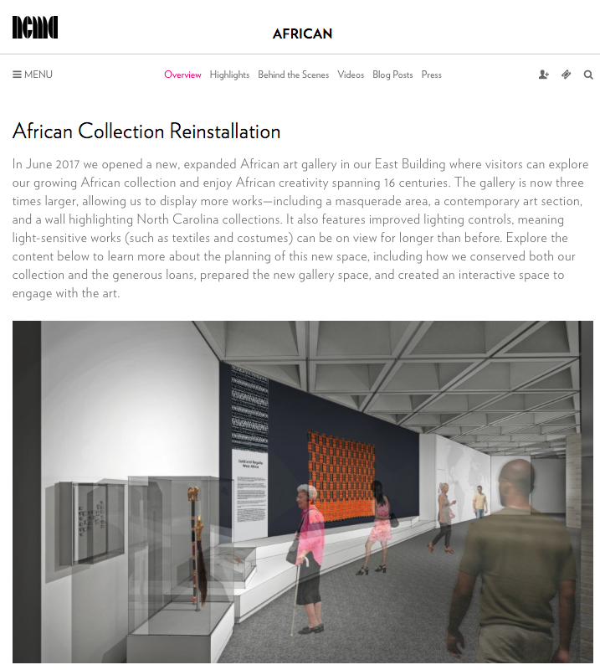
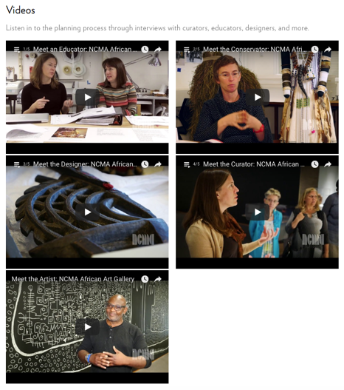
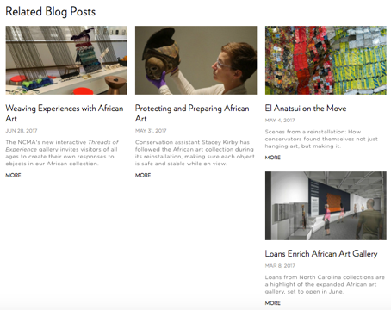
http://ncartmuseum.org/african/african_new_reinstallation

Slide 3
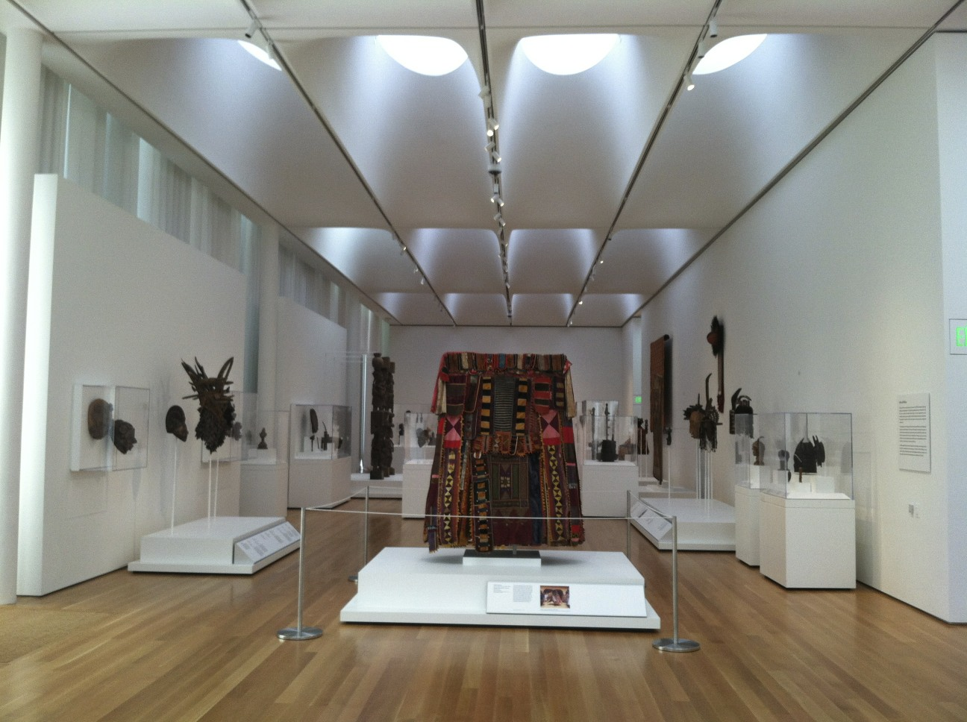
African Art, West Building
Previous Installation

Slide 4
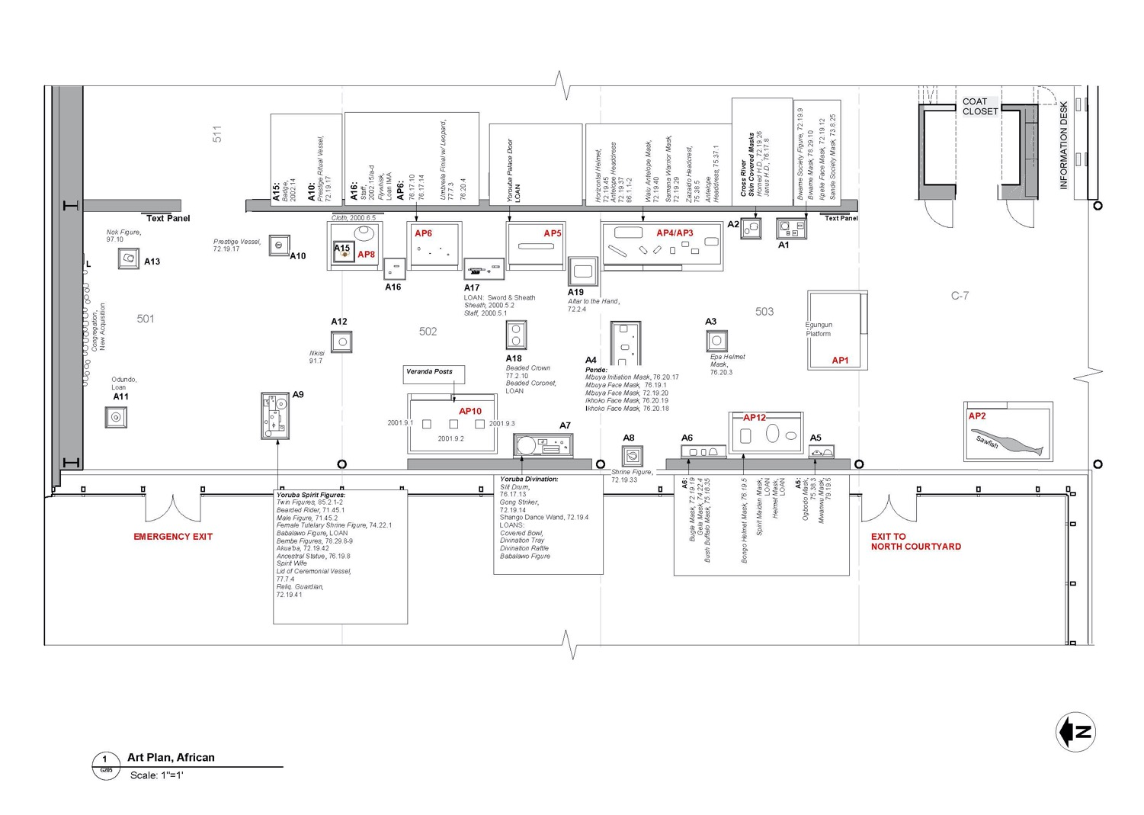
Previous Installation Plan – Approximately 2,000 sq. feet

Slide 5
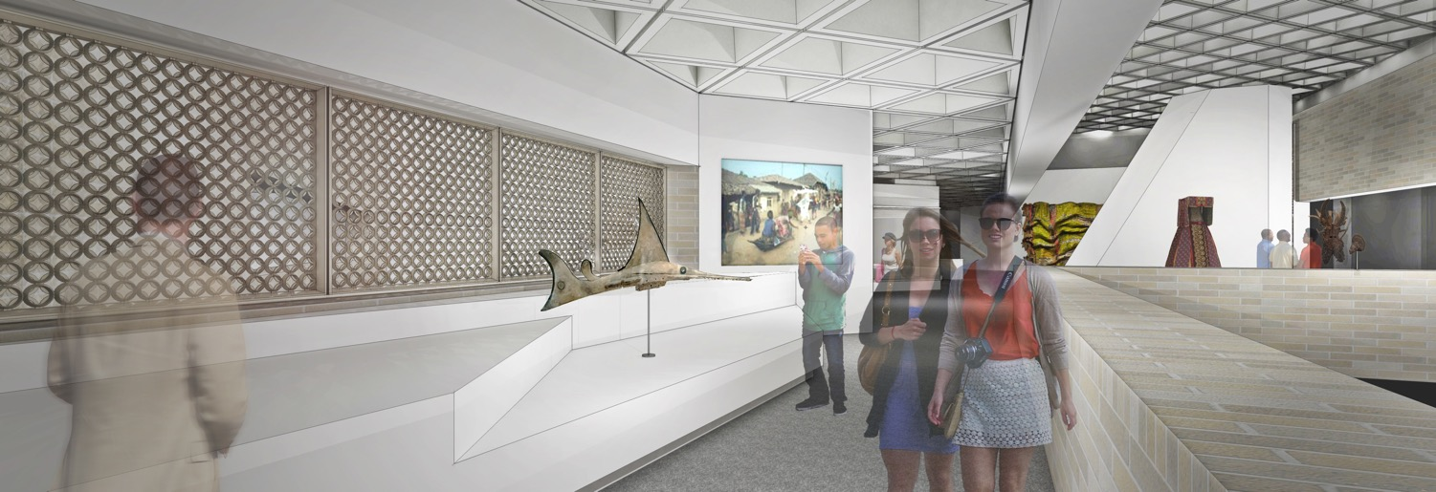
New Installation – New Strengths
3 - 3 1/2 Times the Space; ~6,500 sq. feet
16 Centuries & Across the Continent
More work on view
Rotating Focal Collections
Improved Light Control
Site-specific Installation
Gallery Renderings and Plans thanks to Shannon Harris, NCMA Exhibition Designer

Slide 6
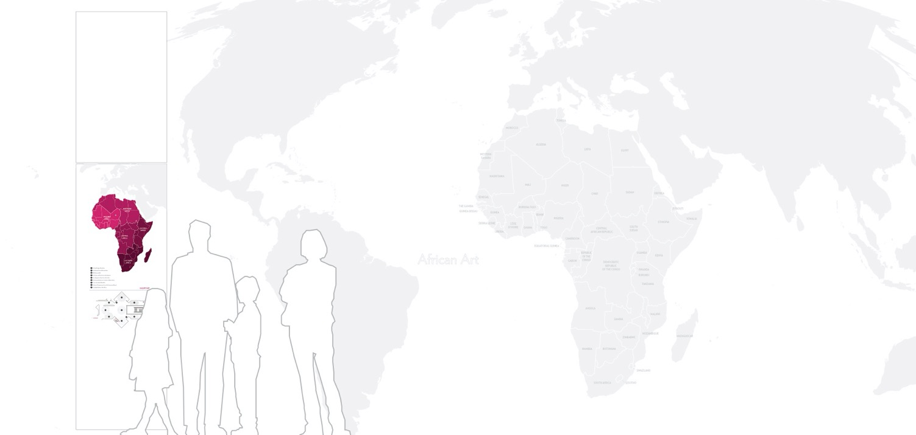
Curatorial Work for the Permanent Reinstallation:
Comparative Research
Zone Definition
New Acquisitions
Identification and Securing of Loans
Advocacy for African work in Contemporary/Modern
Artist Commission Contracting – Victor Ekpuk
Design Collaboration
Conservation Collaboration
Installation Supervision
Label Writing
Docent & Education Staff Mentorship
Educational Programming Consultation
Blog Entries, Videos, & PR Guidance
Meet the Curator: https://www.youtube.com/watch?v=Fl_SD4TXDrQ&list=PL0NN_QRfABNYo7AZZM2cEK8DUisxWRLng&index=4

Slide 7
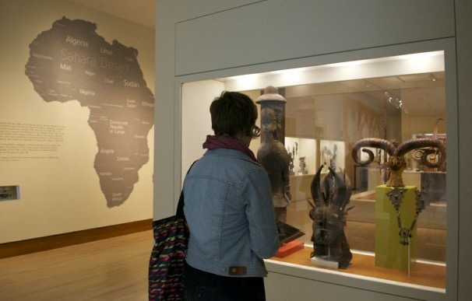
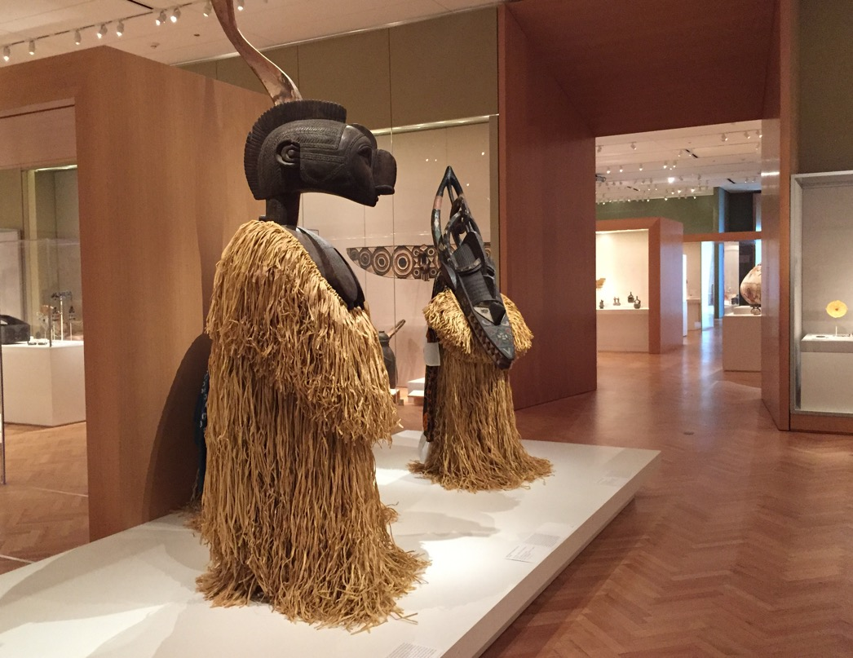
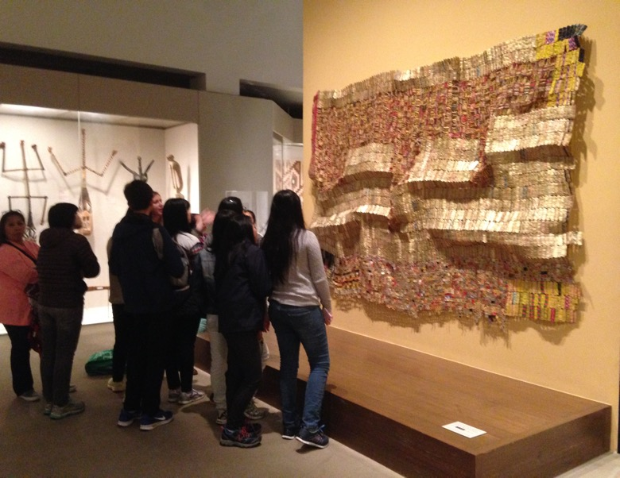
Research Trips:
Art Institute of Chicago, 2015
Indianapolis Museum of Art, 2015
Metropolitan Museum of Art, 2015

Slide 8
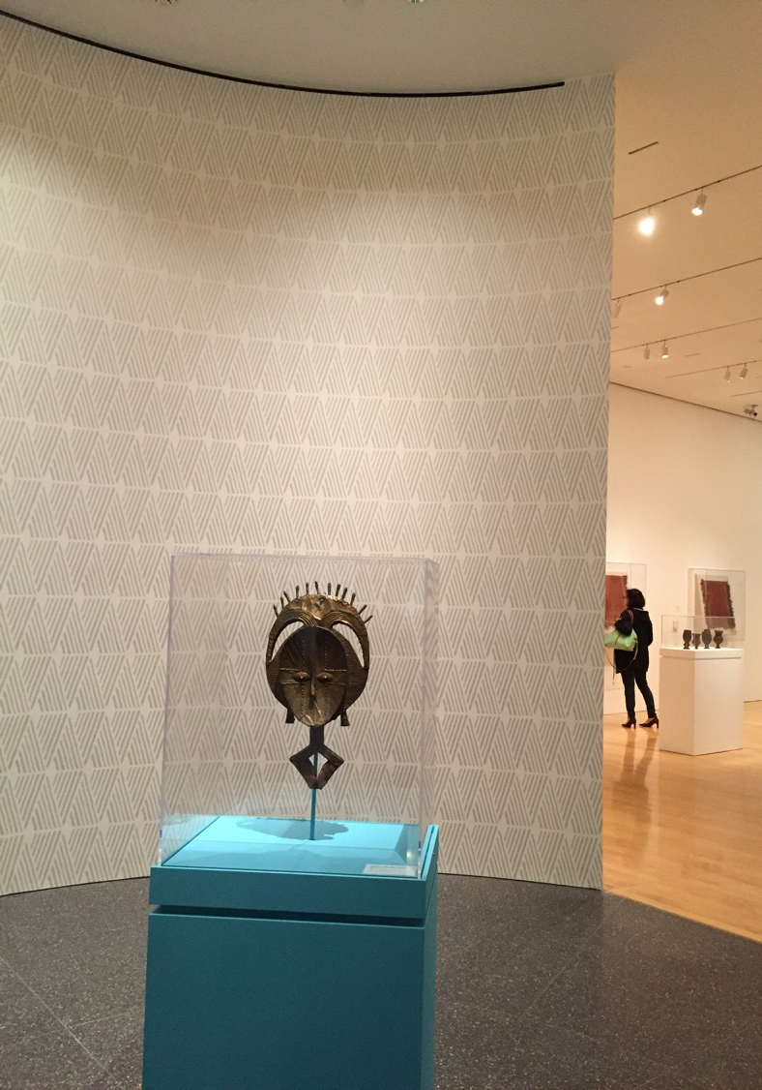
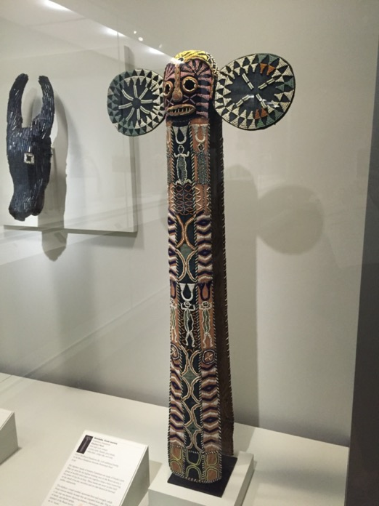
Research Trips:
Philadelphia Museum of Art, 2016
The Museum of Fine Arts, Houston, 2016
Virginia Museum of Fine Arts, 2017

Slide 9
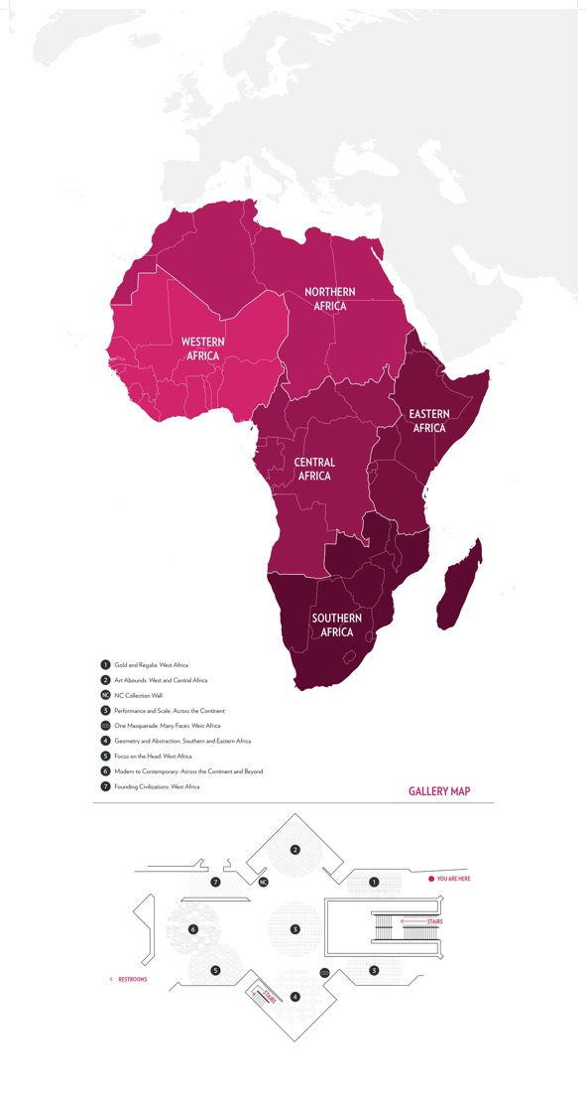

Slide 10
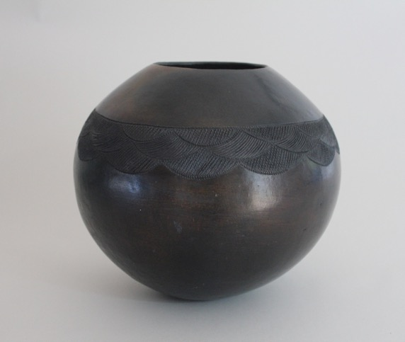
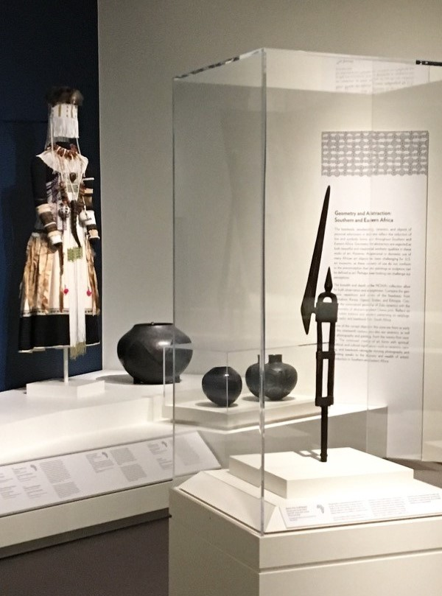
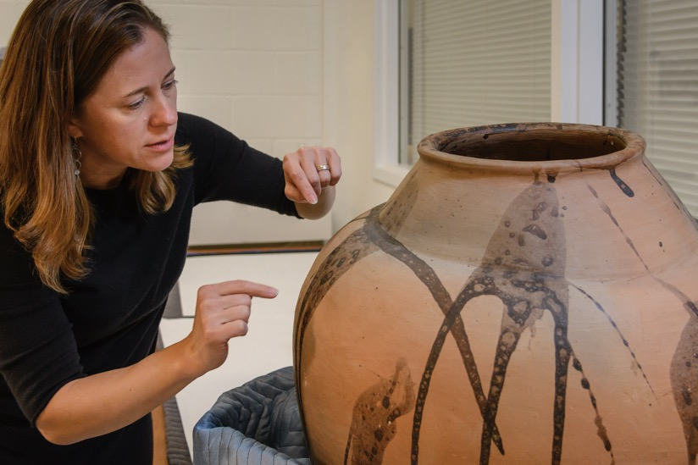
Nesta Mathom Nala
South African, 1940-2005, Beer pot (ukhamba)
2004-2005, Burnished earthenware, shoe polish
Collection of Richard and Jane Levy

Slide 11
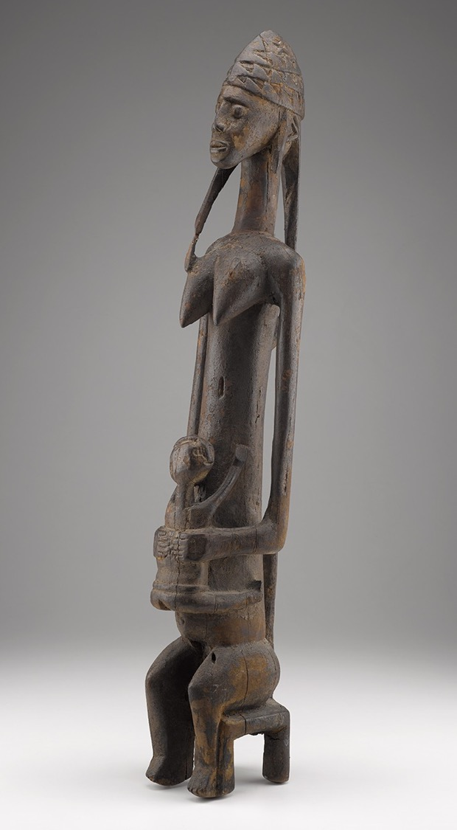
New Acquisitions and Loans:
Blog Entries ---
March 8th
“Loans Enrich African Art Gallery”
http://ncartmuseum.org/blog/view/loans_enrich_african_gallery
September 20th
“Carving Space: Southern African Work in the New African Gallery”
http://ncartmuseum.org/blog/view/carving_space_southern_african_work_in_the_new_african_gallery
Bamana Peoples, Mali, Female Figure (Mother and Child), early 20th century, wood, H. 40 1/2 x W. 8 1/4 x D. 7 1/2 in., Bennett College

Slide 12
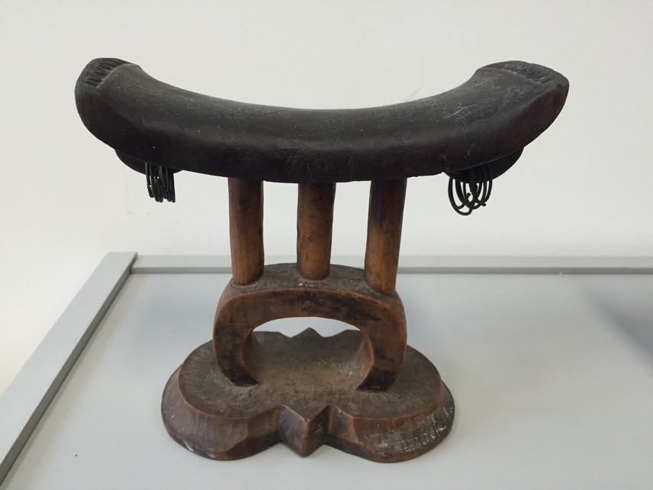
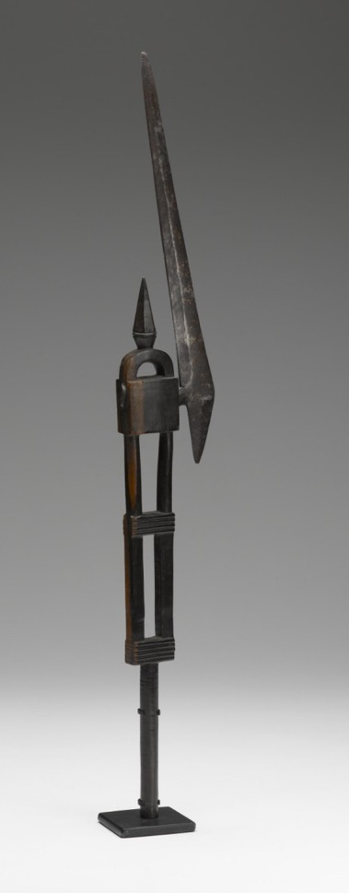
New Acquisitions and Loans:
Status Axe (ndzhanga), Tsonga artist, South Africa
Late 19th–early 20th century, Wood and steel
Purchased with funds from the General Art Fund, 2014 (2014.8)
Headrest (xikhigelo), Tsonga artist,
South Africa, circa 1875-1905, Wood and metal
Gift of Nancy Battle Foster (2016)

Slide 13

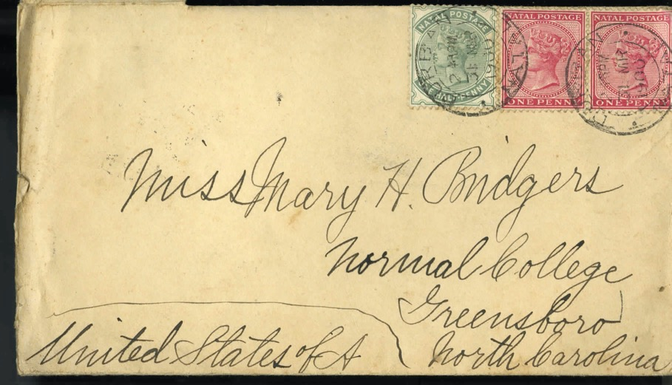
New Acquisitions and Loans:
Rotating into the NC Collects Zone – Dec. 2018
Headrest (xikhigelo), Tsonga artist, & Archival Documentation
South Africa, circa 1875-1905,
Gift of Nancy Battle Foster (2016) & Collection of Nancy Battle Foster, Greensboro

Slide 14
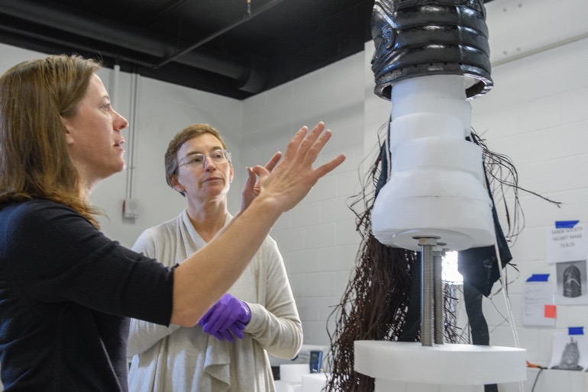
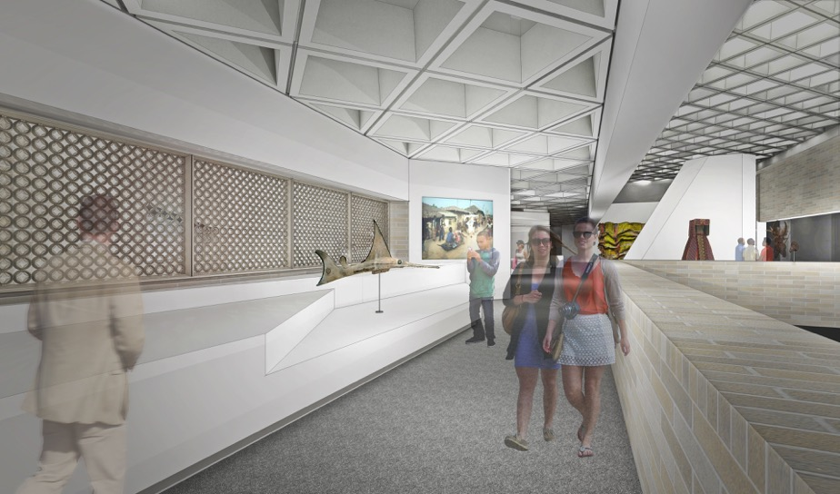
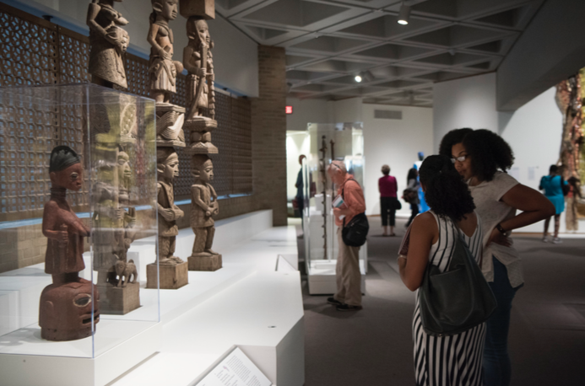
Design, Conservation,
and Installation
Collaborations
Full-Time Staff:
Shannon Harris, Exhibition Designer
Stacey Kirby, Conservator (also 2016 winner of ArtPrize)

Slide 15
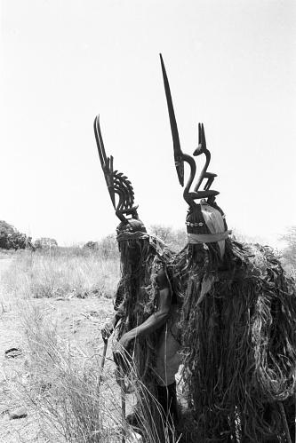
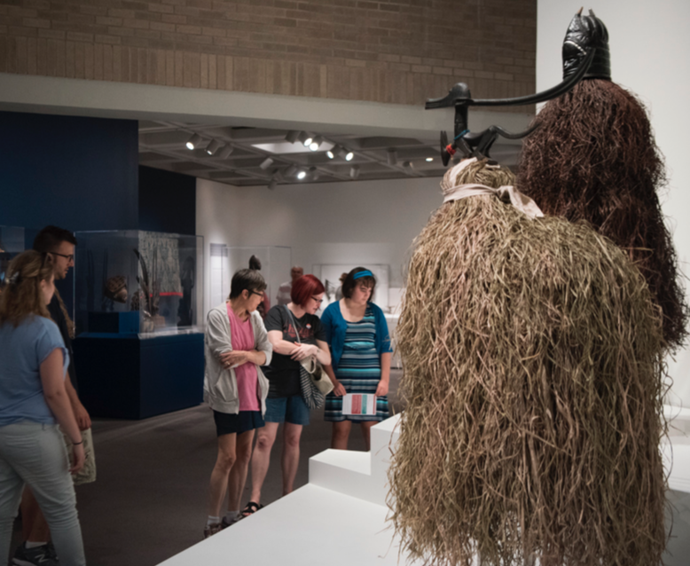
Stacey Kirby, Conservator (also 2016 winner of ArtPrize)
Curator: + Conservator:
Art Historical Research Conservation Genius!
Above:
Eliot Elisofon, Masked Performers wearing Chi Wara headdress, Mali,
1970.

Slide 16
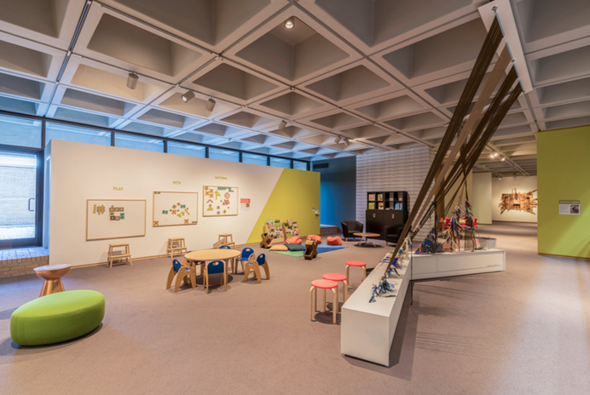
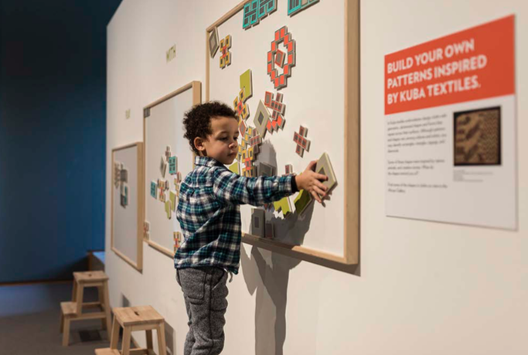
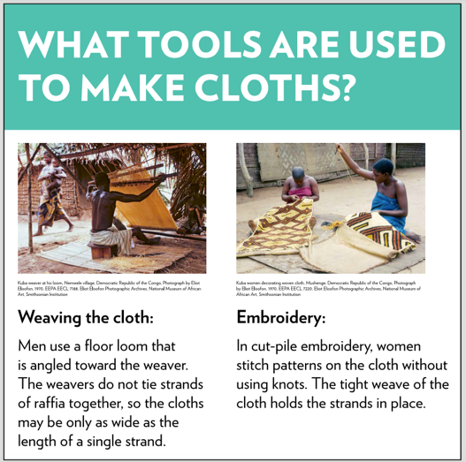
Educational Programming
Visitor Intercepts
Artwork Selection
Contextual Research
Theme Rotations
Educator Collaborations

Slide 17
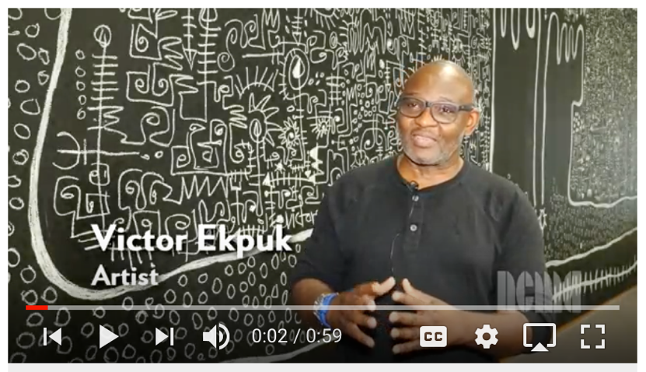
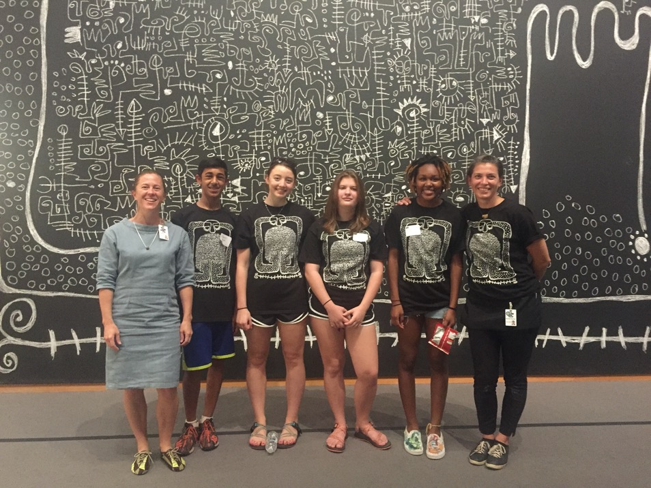
Artist’s Commission
Educational Programming
Community Outreach
https://www.youtube.com/watch?v=GGo6dEDLwl0&list=PL0NN_QRfABNYo7AZZM2cEK8DUisxWRLng&index=5

Slide 18
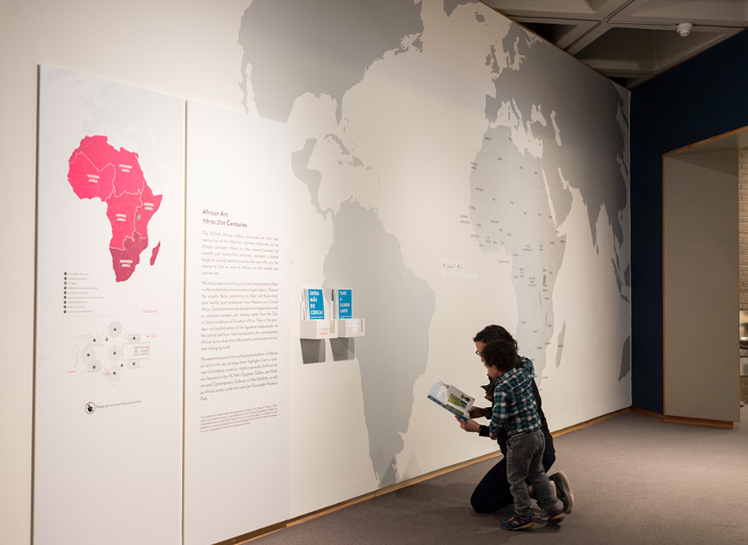
Docent Training
Three Initial Tour Ideas:
By the Patterns
Figures, Faces, and Forms
Style: Comparative Looking

Slide 19

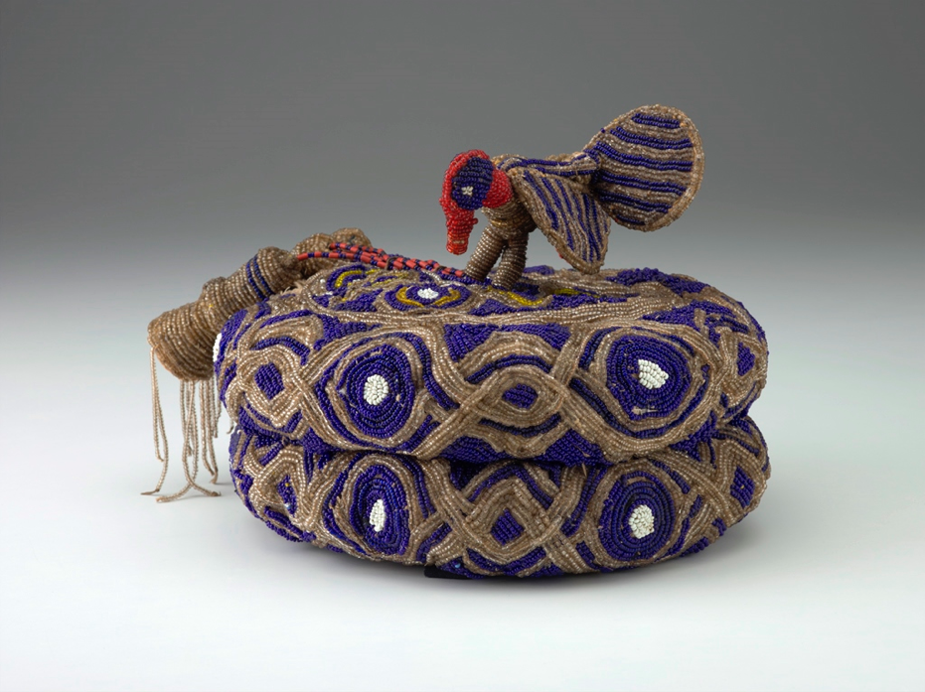
Tour 1: By the Patterns
Beaded Coronet (orikogbofo)
Yoruba artist, Nigeria or Benin
Before 1898
Glass beads, cloth, thread and basketry
Gift of Dr. Rhonda Wilkerson in honor of Lawrence J. Wheeler, 2014.19

Slide 20
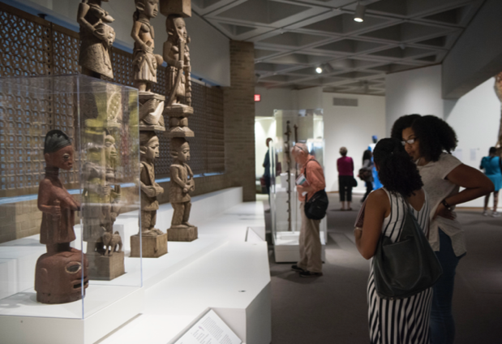
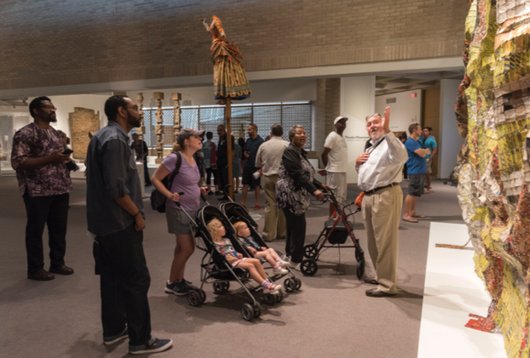
Curatorial Work for the Permanent Reinstallation:
Comparative Research
Zone Definition
New Acquisitions
Identification and Securing of Loans
Advocacy for African Contemporary/Modern
Artist Commission Contracting – Victor Ekpuk
Design Collaboration
Conservation Collaboration
Installation Supervision
Label Writing
Docent & Education Staff Mentorship
Educational Programming Consulting
Blog Entries, Videos, & PR Guidance
Meet the Curator: https://www.youtube.com/watch?v=Fl_SD4TXDrQ&list=PL0NN_QRfABNYo7AZZM2cEK8DUisxWRLng&index=4

